Slide 1


Human Override: Knowing When to Step In
Why human intervention remains essential in AI-assisted operations

Slide 2

Human Override: Knowing When to Step In
When AI Needs Human Guidance
Recognising the limits of AI systems
AI makes mistakes
Context often gets missed
Humans catch critical errors
Judgement matters most
You are the safeguard

Slide 3
Human Override: Knowing When to Step In
How AI Systems Fail
Understanding where automation breaks down
Trained on past data, struggles with change
Confidently wrong with no self-awareness
Missing nuance, tone, cultural context
No understanding of real consequences
Poor handling of edge cases

Slide 4
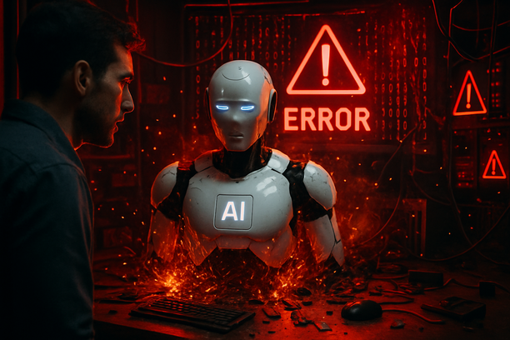
Human Override: Knowing When to Step In
AI's Blind Spots in Resource Industries
Specific risks in agriculture, mining, and energy operations
Weather patterns change faster than training updates
Equipment conditions vary by location and age
Safety protocols require human interpretation
Environmental factors need local knowledge
Regulatory changes happen in real-time

Slide 5

Human Override: Knowing When to Step In
Recognising the Warning Signs
When AI signals need human attention
Overly confident outputs from incomplete data
Repeated errors in the same area
Results contradicting known facts or policies
Sudden shifts in tone or logic
System flags uncertainty or incomplete responses
Your gut feeling that something is off

Slide 6
Human Override: Knowing When to Step In
Common Override Triggers
Red flags that demand immediate human review
Numbers that don't pass basic sense checks
Recommendations ignoring safety protocols
Solutions assuming perfect conditions
Advice contradicting recent field experience
Outputs that seem suspiciously perfect

Slide 7

Human Override: Knowing When to Step In
Building Override Confidence
Practice with realistic scenarios regularly
Identify the shift from helpful to risky
Rehearse responses out loud or in writing
Reflect on past hesitations to learn patterns
Practical steps to strengthen decision-making
Trust your instincts as valid data points

Slide 8

Human Override: Knowing When to Step In
Scenario Practice: Field Decisions
Applying override judgement to real situations
AI recommends equipment changes mid-season
System suggests ignoring weather warnings
Algorithm proposes cost cuts affecting safety
Automated schedule conflicts with crew limits
Output assumes resources that aren't available

Slide 9
Human Override: Knowing When to Step In
What to Remember
AI makes mistakes
Humans catch what AI misses
Context matters most
Trust your instincts
Step in early, step in often
You are the final check
The essentials worth keeping in mind

